Slide 1
MACHINE LEARNING
518H0104 – CHƯƠNG THÀNH LONG
518H0328 – NGÔ NGỌC PHƯƠNG BÌNH

Slide 2
Present machine learning issues by building machine learning models for classification problems.
1) Standardize data: using a dataset of numeric and categorical (nominal) types(1p)
2) Processing with unbalanced data, it means there is unequal/or bias distribution of classes in the dataset. (1p)
3) Draw a chart showing statistical information of the dataset: quantity by labels (classes). (1p)
4) Solving the problem by using classification models: kNN, NB, SVM, Logistic Regression, MultiLayer Perceptron (i.e FFNN). (2p)
5) Using early stopping for training process, using validation dataset. (1p)
6) Train the model using parameters: batch size and epoch number. (1p)
7) Display model evaluation results with different measures. (1p)
8) Present the overfiting issue and illustrate this issue through examples. (1p)
9) Presenting (by a program) an example of using Convolution Neural Network or Long Short Term Memory (2p)

Slide 3
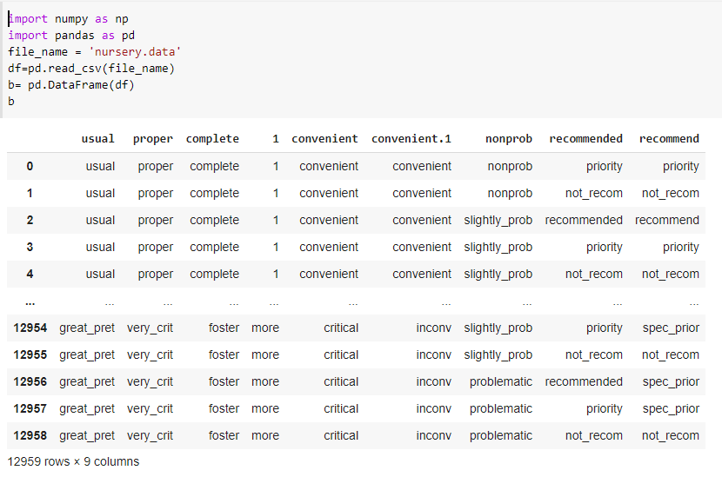
1) Standardize data: using a dataset of numeric and categorical (nominal) types(1p)

Slide 4
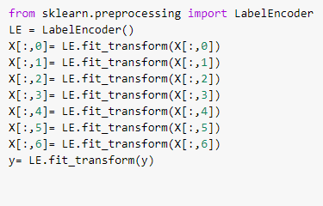
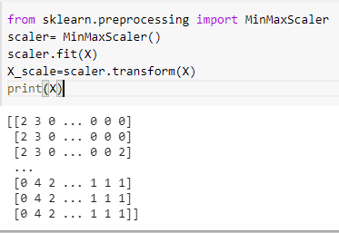
Change to numeric data by using sklearn library.

Slide 5
2) Processing with unbalanced data, it means there is unequal/or bias distribution of classes in the dataset. 3) Draw a chart showing statistical information of the dataset: quantity by labels (classes). (1p)

Slide 6
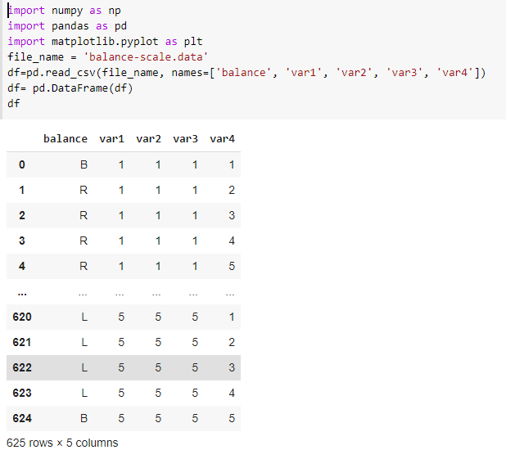

Slide 7
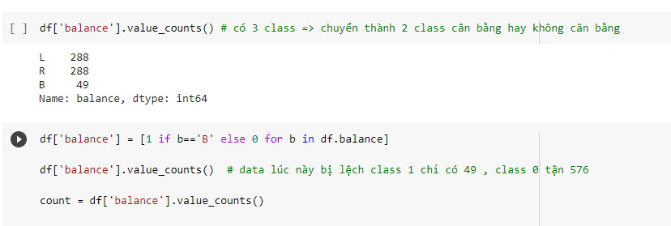
Using another data to solve this problem.

Slide 8
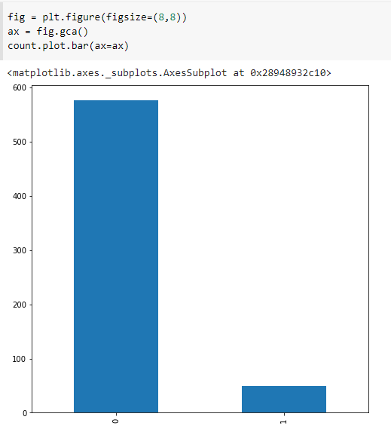
This diagram below show how different between 2 classes (0,1) ➔ unbalance

Slide 9
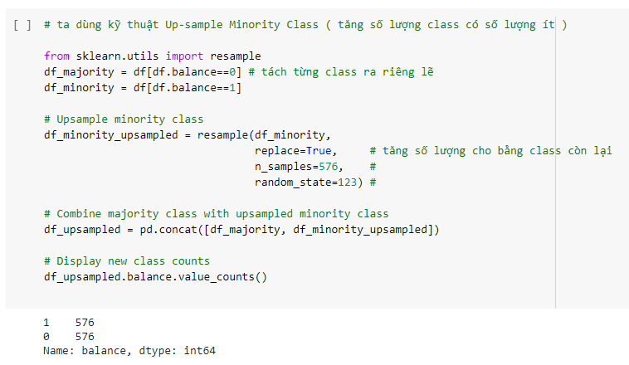
By using Up-sample Minority class We try to separate class Up-sample for class and combine

Slide 10
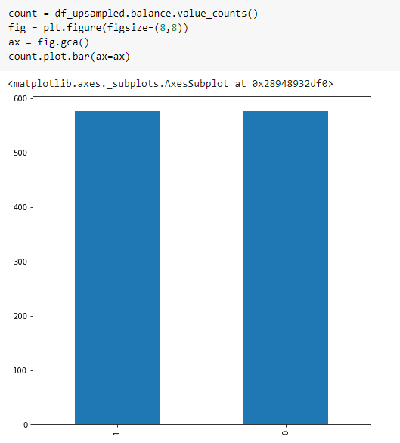
Data after balance

Slide 11
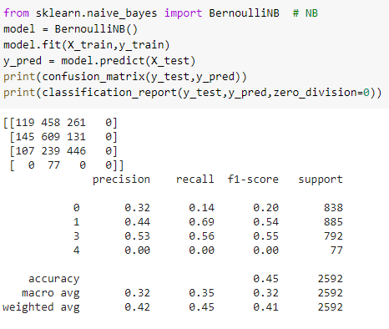
4) Solving the problem by using classification models: kNN, NB, SVM, Logistic Regression, MultiLayer Perceptron (i.e FFNN). (2p)
Naïve Bayes:Naive Bayes classifiers are a collection of classification algorithms based on Bayes’ Theorem. It is not a single algorithm but a family of algorithms where all of them share a common principle, i.e. every pair of features being classified is independent of each other.

Slide 12
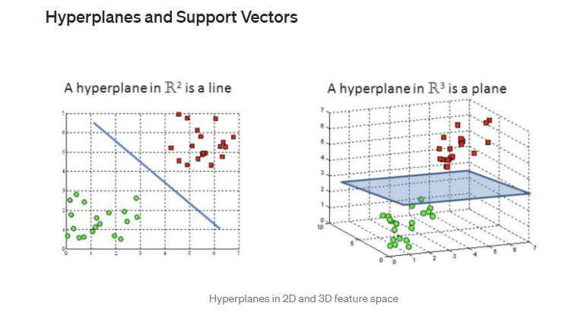
SVM: The objective of the support vector machine algorithm is to find a hyperplane in an N-dimensional space(N — the number of features) that distinctly classifies the data points.

Slide 13
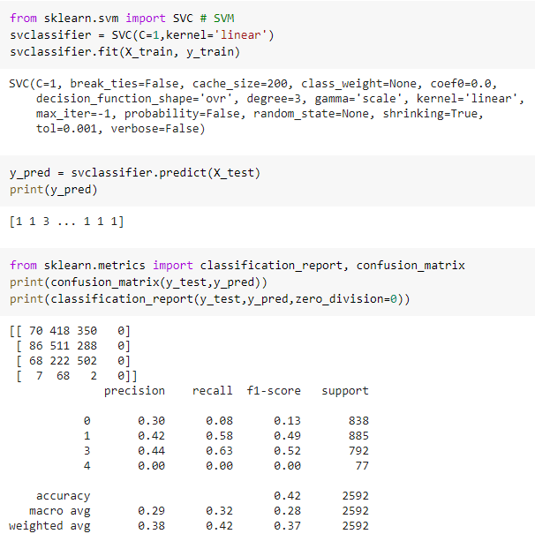

Slide 14
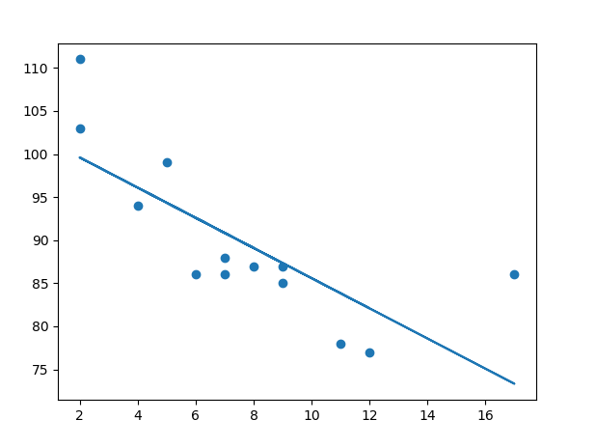
Linear regression: Linear regression uses the relationship between the data-points to draw a straight line through all them. This line can be used to predict future values.

Slide 15
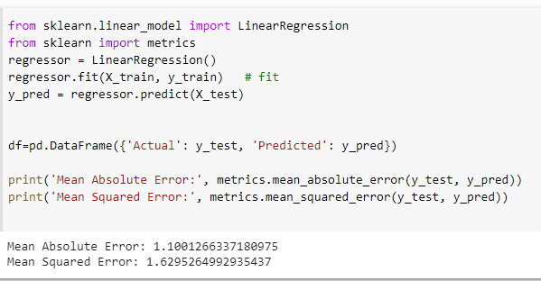

Slide 16
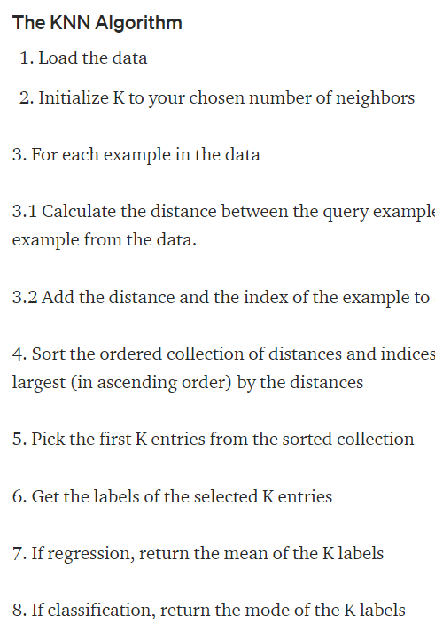
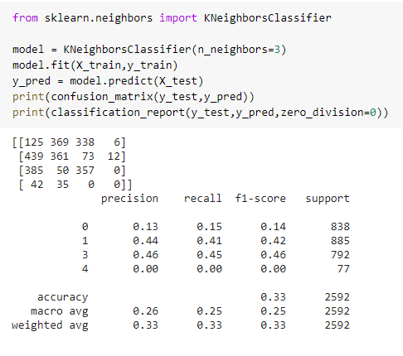
KNN:K-Nearest Neighbors The KNN algorithm assumes that similar things exist in close proximity. In other words, similar things are near to each other.

Slide 17
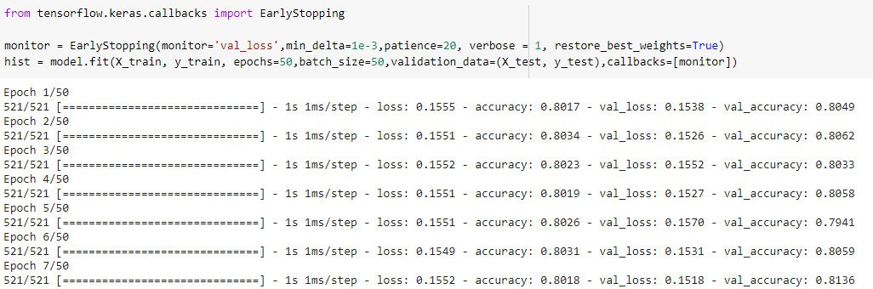
5) Using early stopping for training process, using validation dataset. (1p)
Early stopping is a method that allows you to specify an arbitrary large number of training epochs and stop training once the model performance stops improving on a hold out validation dataset.

Slide 18
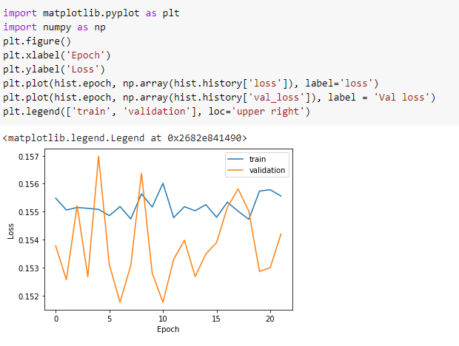

Slide 19
6) MultiLayer Perceptron and Train the model using parameters: batch size and epoch number. (1p)
The batch size is a hyperparameter that defines the number of samples to work through before updating the internal model parameters
Batch Gradient Descent. Batch Size = Size of Training Set
Stochastic Gradient Descent. Batch Size = 1
Mini-Batch Gradient Descent. 1 < Batch Size < Size of Training Set

Slide 20
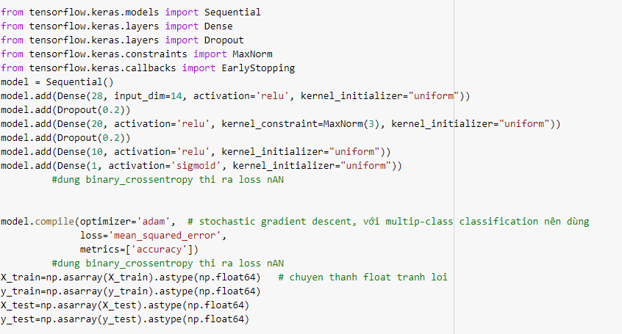

Slide 21
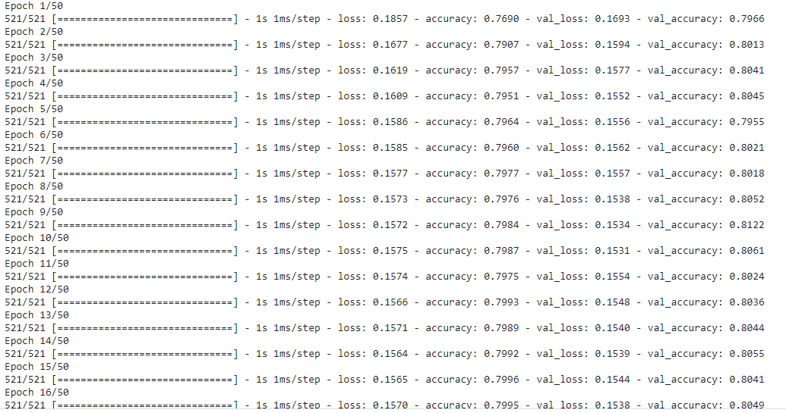

Slide 22
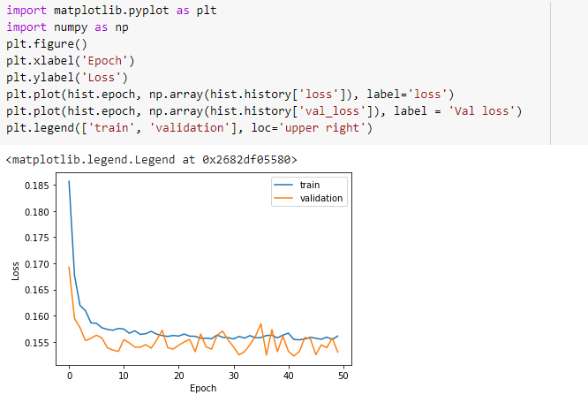

Slide 23
8) Present the overfiting issue and illustrate this issue through examples. (1p)
A statistical model is said to be overfitted, when we train it with a lot of data
When a model gets trained with so much of data, it starts learning from the noise and inaccurate data entries in our data set. Then the model does not categorize the data correctly, because of too many details and noise.

Slide 24
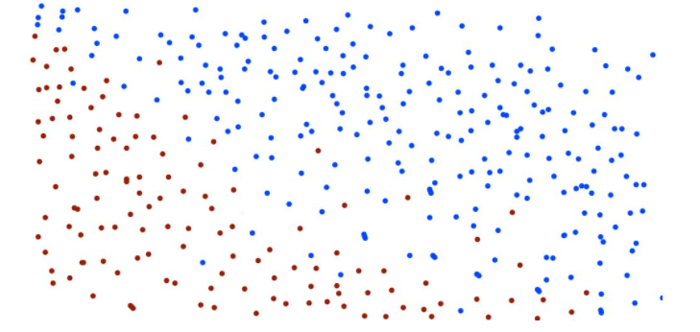
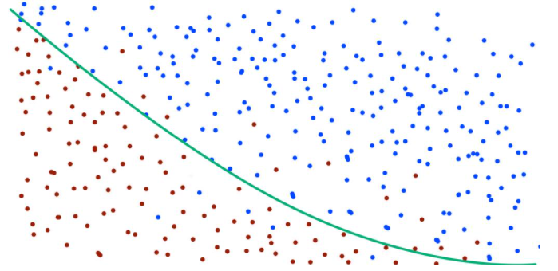
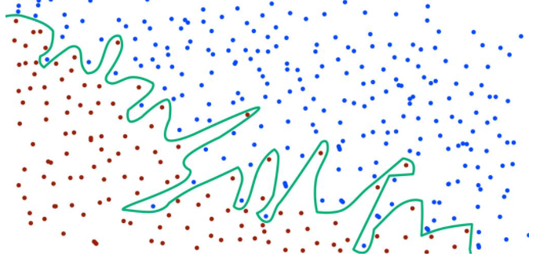
Example:
Trainning set
After 1 day,learning,still have wrong
Perfect learning

Slide 25
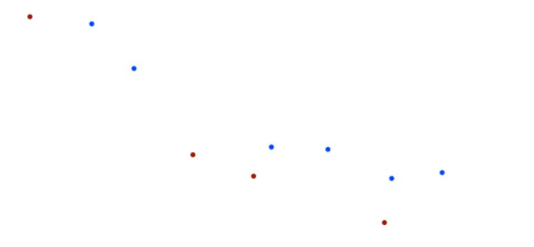
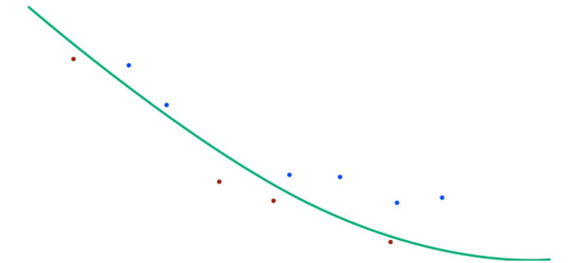
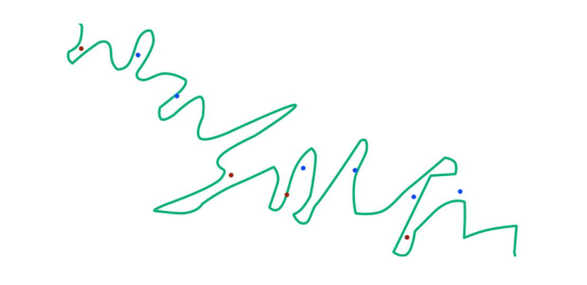
But…
Testing set
On training set : not ok
On testing set : 100% exactly
On training set : 100%
On testing set: not ok

Slide 26
9) Presenting (by a program) an example of using Convolution Neural Network or Long Short Term Memory (2p)
Convolutional Neural Networks (CNN)
Convolutional Neural Networks (CNN) is one of the variants of neural networks used heavily in the field of Computer Vision. It derives its name from the type of hidden layers it consists of. The hidden layers of a CNN typically consist of convolutional layers, pooling layers, fully connected layers, and normalization layers.

Slide 27
